Slide 1

VIDEO GAMES VS EUROPEAN ECONOMY
Miguel Merry del val

Slide 2



NINTENDO
SONY
MICROSOFT

Slide 3


MAIN ECONOMIC INDICATORS
GDP PER CAPITA
INFLATION RATE
UNEMPLOYMENT RATE

Slide 4

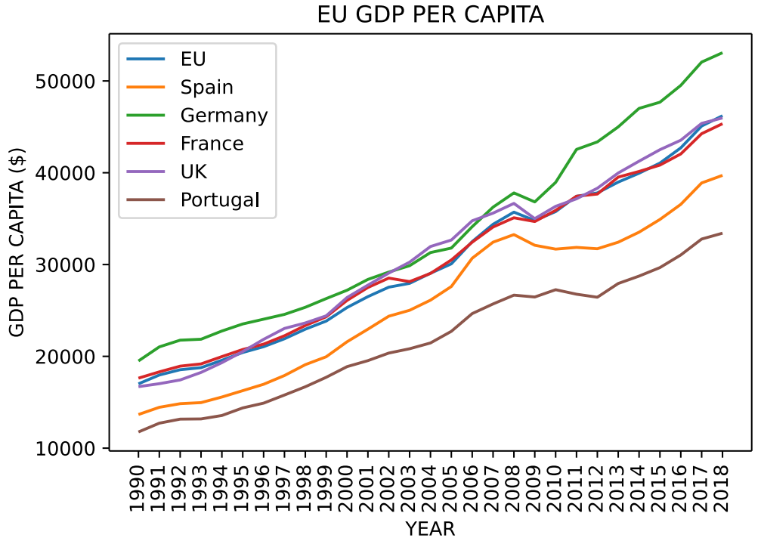
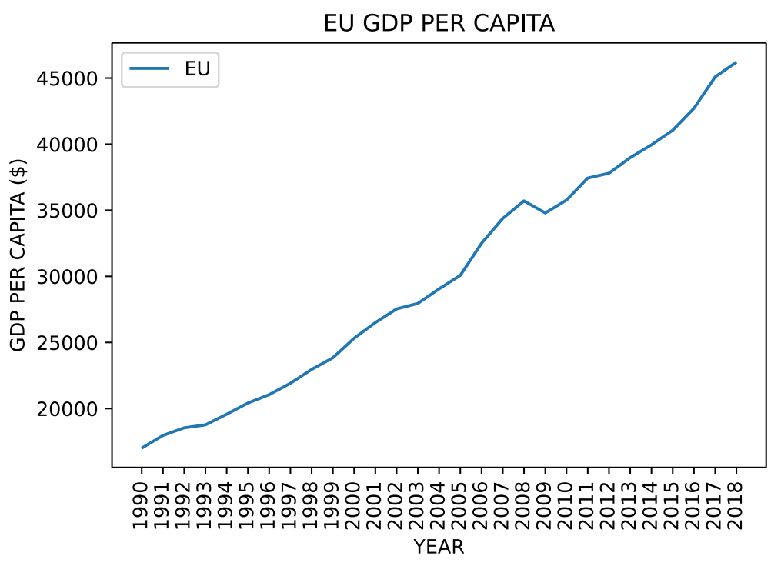
GDP PER CAPITA

Slide 5
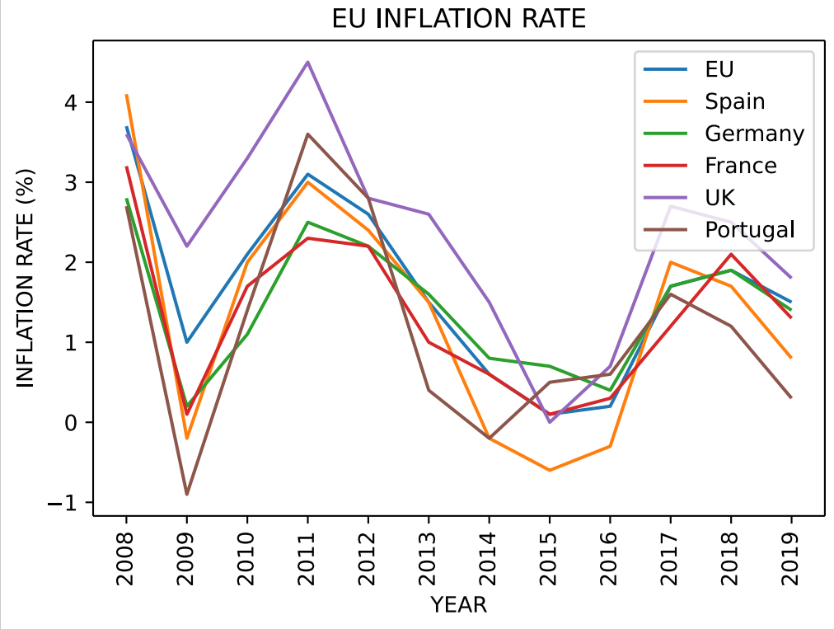
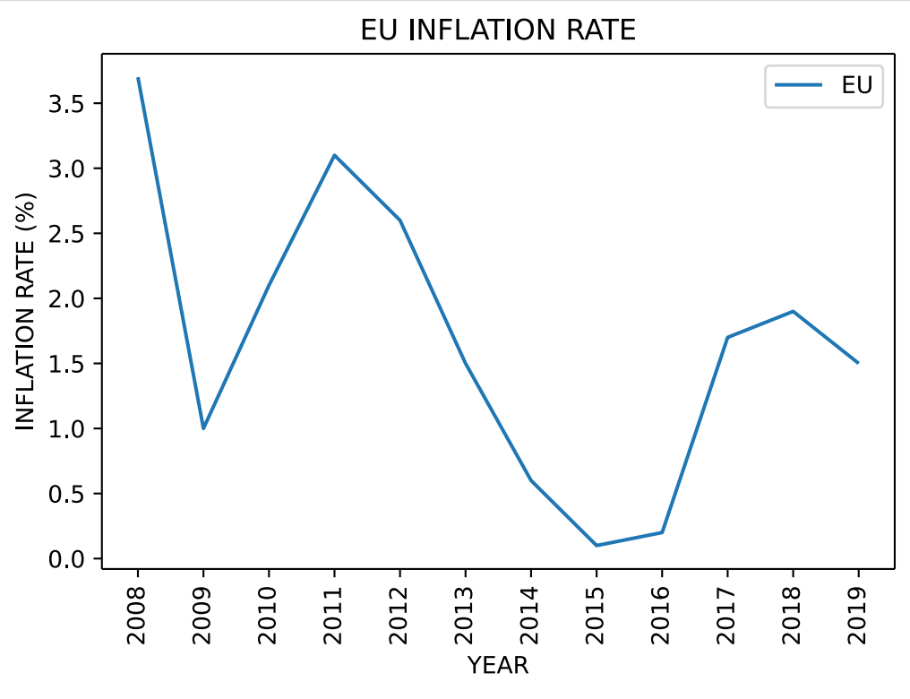
INFLATION RATE

Slide 6
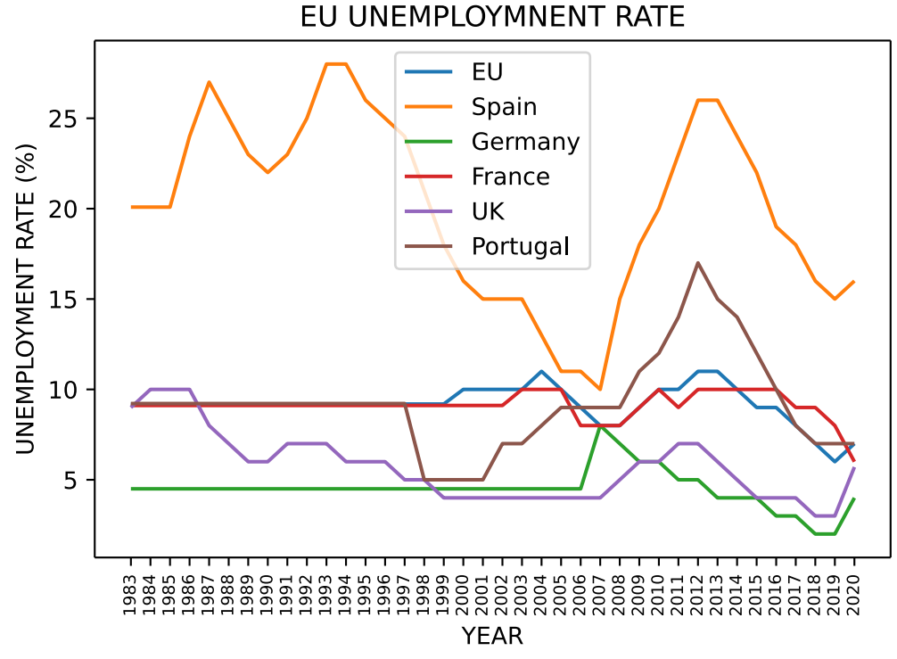
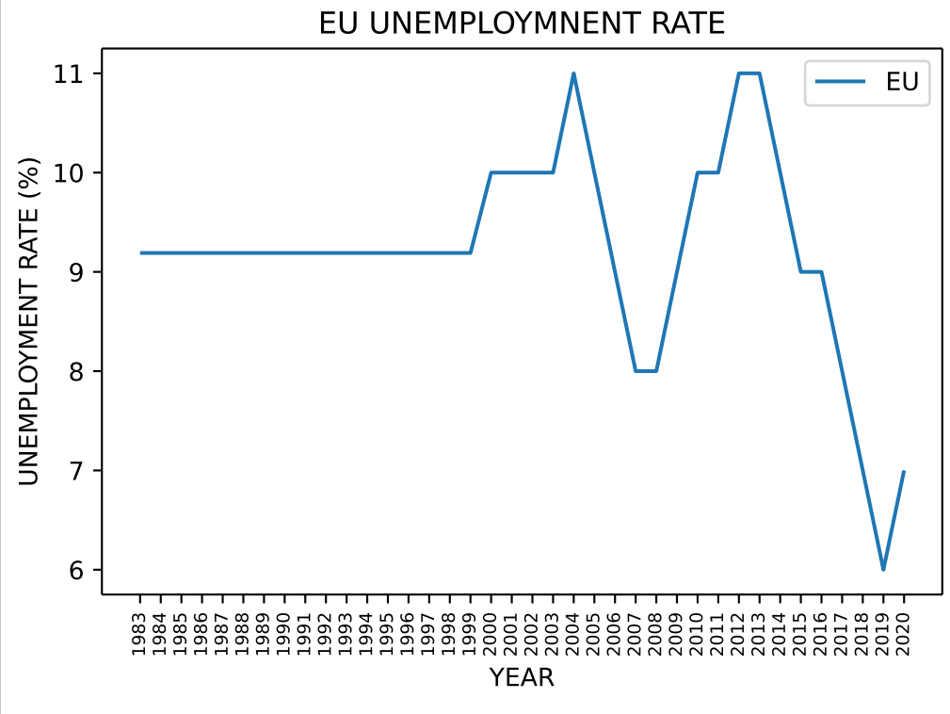
UNEMPLOYMENT RATE

Slide 7
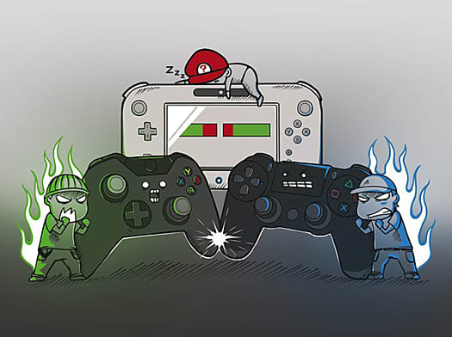
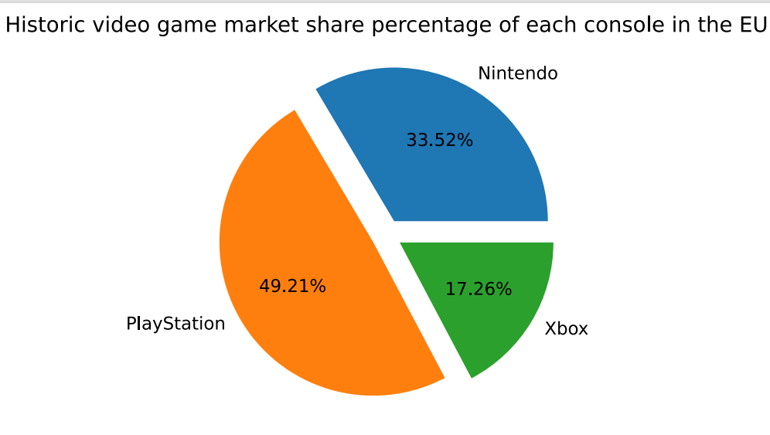
CONSOLE WARS

Slide 8
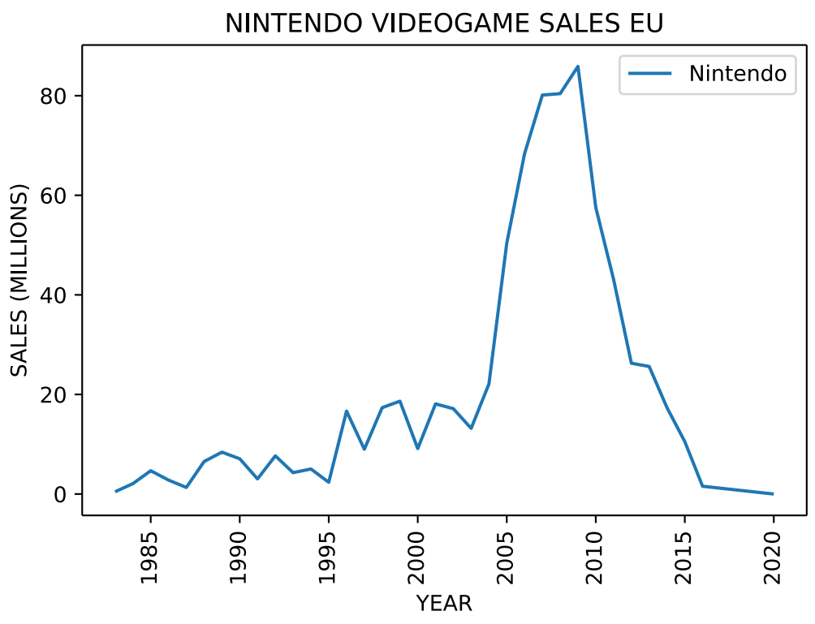


Slide 9

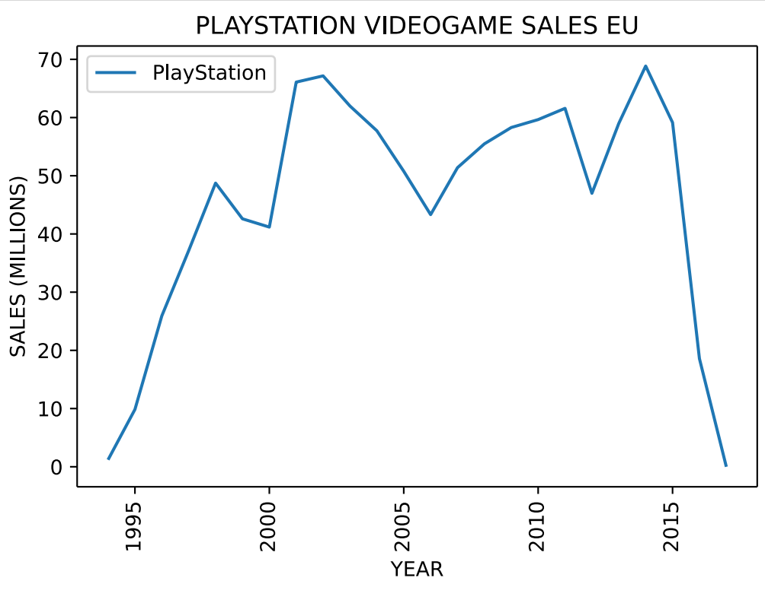

Slide 10

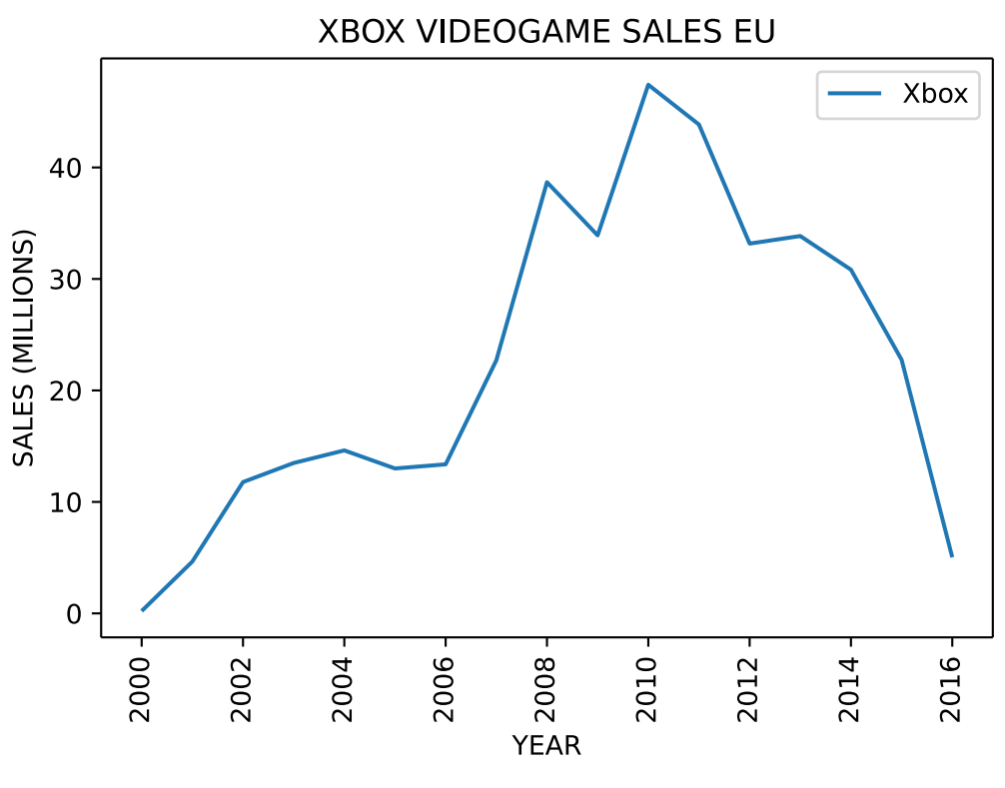

Slide 11
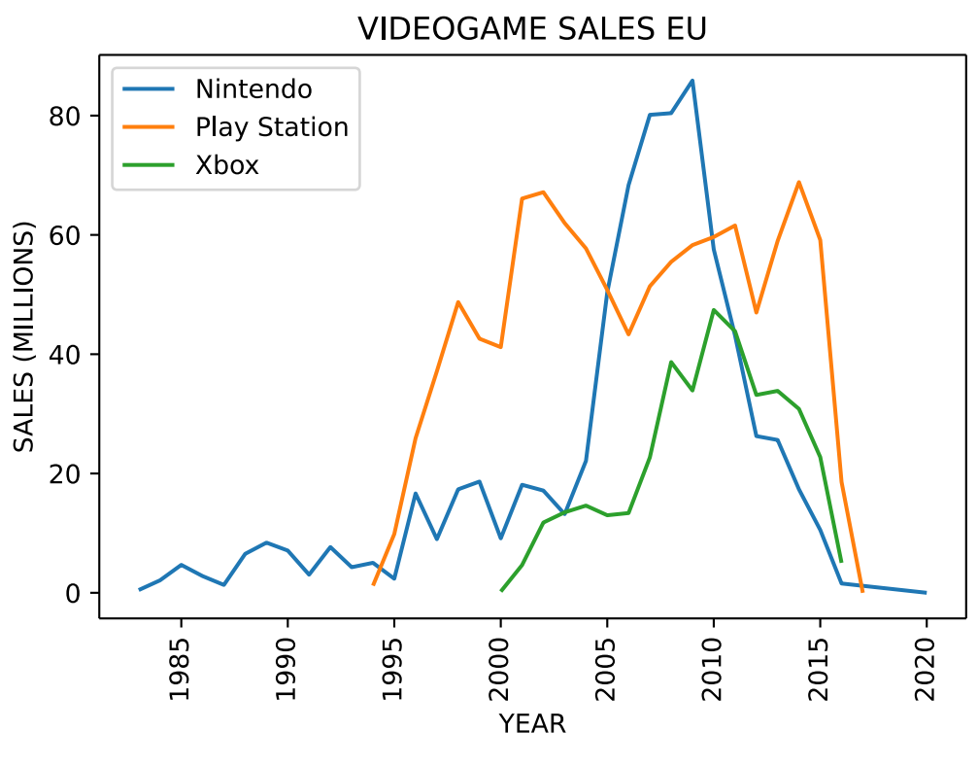
CONSOLE WARS

Slide 12
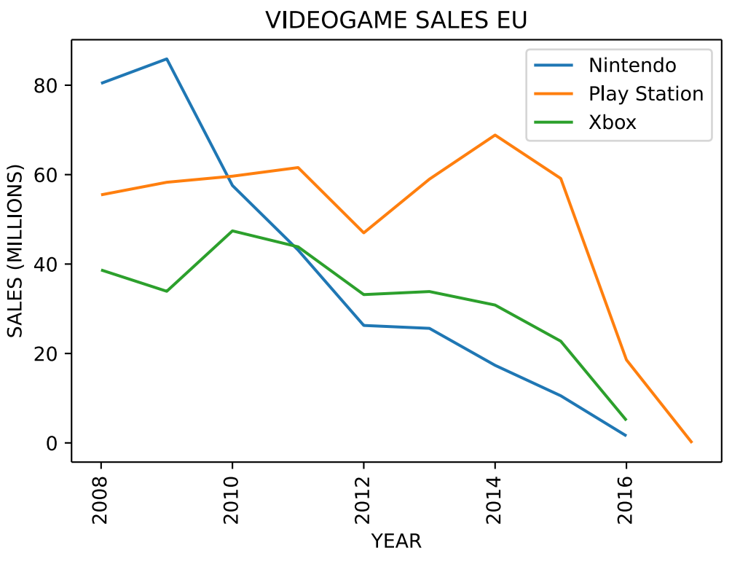
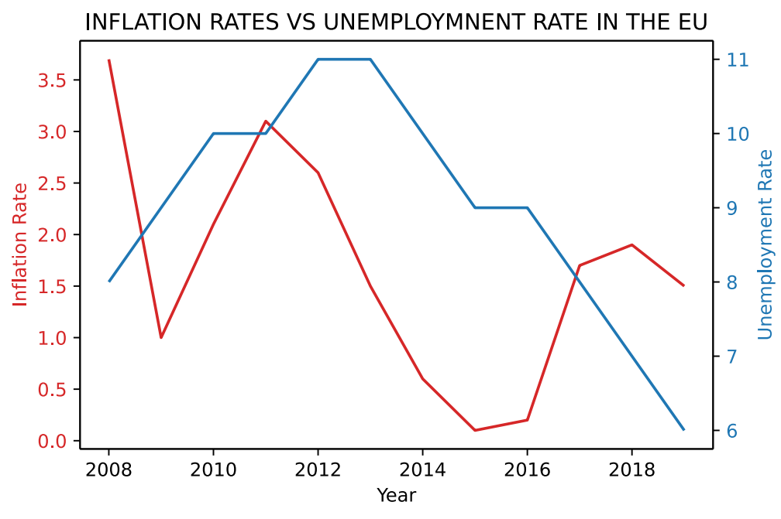
COMPARISON

Slide 13
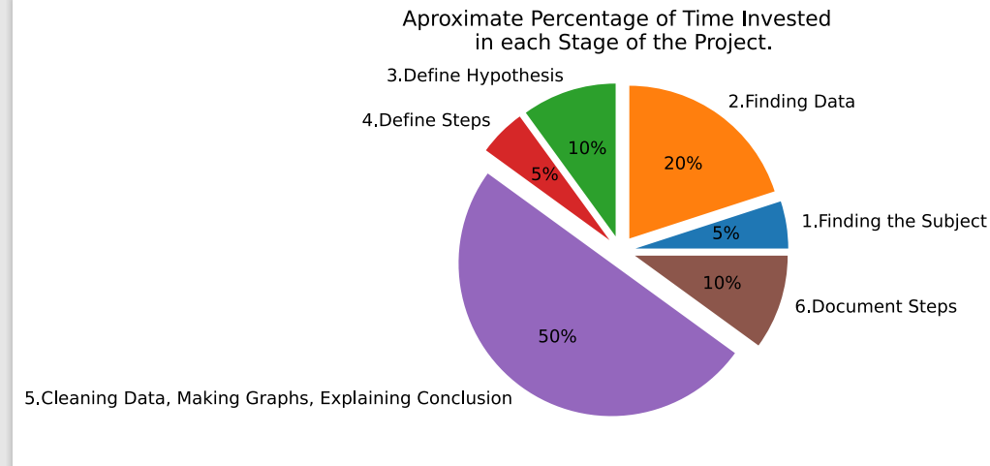
TIME SPENT

